Slide 1
Lesson activity templates
Zoë Johnson King

Slide 2
AfL
(Assessment for Learning)
Notes:
Also known as formative assessment, educative assessment (see especially Black and Wiliam “Inside the Black Box”)

Slide 3
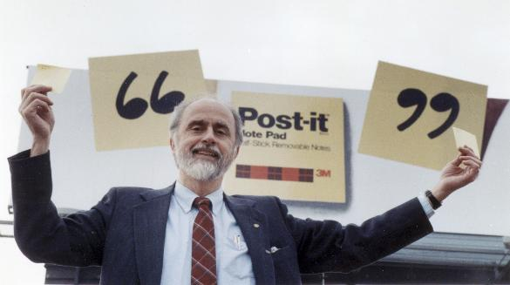
STICK ’EM UP!
I’d like to get some feedback on how this topic ([TOPIC]) has gone for you so far.
Write an answer for each question onto your post-it notes and come stick them up on the sheets of paper.
What have you learnt?
What are you not sure about?
What questions do you have?
Notes:
After 2 or 3 classes, best done at the end of a lesson – then you can take the sheets away and look for things to address in the next lesson

Slide 4
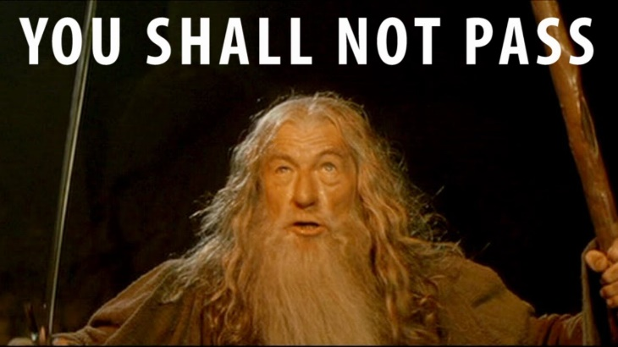
EXIT PASS
I will give you a slip of paper on which you must fill out the answers to a series of questions, to give me helpful (anonymous) feedback from the whole class.
Please hand the slips to me on the way out.
No exiting if you haven’t got a pass!
Notes:
Variation on the above; can use a mixture of content questions and “how do you feel this class is going?” type questions

Slide 5
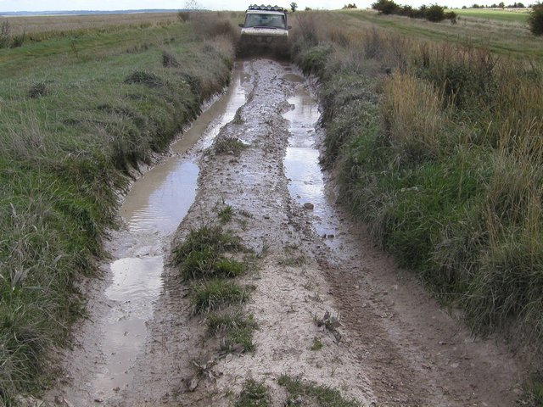
MUDDIEST POINT
Identify your MUDDIEST POINT from the last 4 lessons – the point or question that is least clear for you.
Write it on a card and hand it to me as you leave.
I will clear up your muddiest points in the next class!
Notes:
Variation on the above focusing on content

Slide 6
MUDDIEST POINT
Identify your MUDDIEST POINT from the last 4 lessons – the point or question that is least clear for you.
OK, now we are going to move into a circle and take turns to lead class discussion to resolve our muddy points!
Notes:
Possible extension for a small class (~20 students), cool way to help students help one another. N.B. this process may take a whole lesson

Slide 7
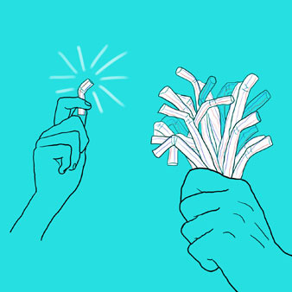
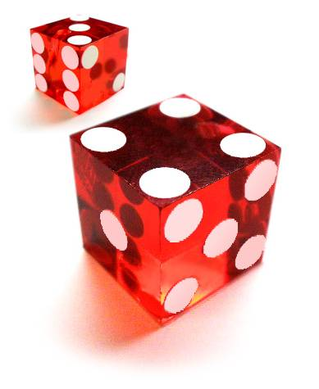
THE RANDOMIZER
I am going to use a random name-selection method to pick one or two individuals, who I will ask to feed back to the whole group on how this class went and what we did.
I’m telling you at the beginning that you will have to do this, so you can be thinking of what to say throughout!
Notes:
Google “random name generator” – I like to use the spinning wheel on classtools.net (it cheers to “congratulate” the student selected!). It’s good practice to do this regularly in a discussion-based class until everyone has had a turn being the class reporters.

Slide 8
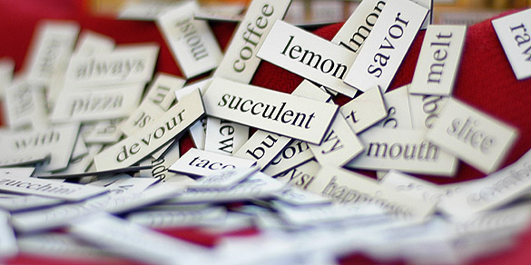
5 WORDS ONLY
In groups of 4, using 5 WORDS only, summarize the most important piece of learning from the last X classes.
After 2 minutes, I will ask each group to read theirs out and we will vote for the best one!
Notes:
Variations: 5 sentences instead of words, or start with 5 sentences and get it down to 5 key words, or start with listing them individually and then share in groups and agree on a group set of answers

Slide 9
i-Clickers: TRUE OR FALSE?
Answer using your i-Clickers: TRUE (A) or FALSE (B)?
STATEMENT
Notes:
Helpful for large classes. For common misconceptions or difficult ideas – go over it again if a significant number of students get the wrong answer.

Slide 10
HOWDY PARDNER
I will hand each of you a question card or an answer card.
Your challenge is to find your partner and match yourselves up IN SILENCE!
The tricky bit: there may be two answers for some questions, or two questions for some answers…
Notes:
Best with a small class (~20). Useful to test comprehension. Variation: allow talking, let students direct one another. Development: do it as DOMINOES!

Slide 11
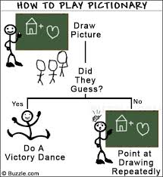
ABSTRACT NOUN PICTIONARY!
We are going to draw some abstract nouns from the course so far (e.g. “philosophy”, “education”).
HOW TO WIN POINTS:
Guess correctly = 1 point
Draw & someone guesses within 2 minutes = 3 points
Notes:
Another good one to test understanding of content in an open-ended way; cards of things to draw should contain key terms from the class. Ask drawers why they drew what they did and guessers how they guessed.

Slide 12
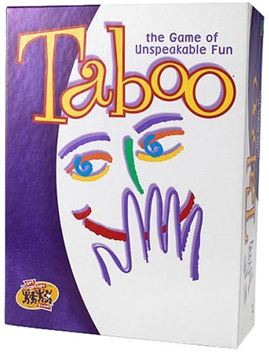
ABSTRACT NOUN TABOO!
We are going to describe some abstract nouns from the course so far (e.g. “philosophy”, “education”).
YOU ARE NOT ALLOWED TO SAY THE NOUNS!!
HOW TO WIN POINTS:
Guess correctly = 1 point
Describe & someone guesses within 1 minute = 3 points
Notes:
Variation on Pictionary (but easier).

Slide 13
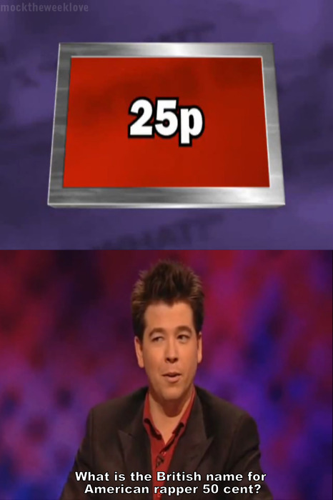
If this is the answer, what is the question?
I will show you a series of answers to a bunch of questions.
It is your job to work out what the question was!
1. Answer
2. Answer
3. Answer
4. Answer
Notes:
Good activity to test understanding of content in an open-ended way; answers can be vague enough to support multiple questions (e.g. “Non-Cognitivism”), can go around the room asking students to each name a distinct question to which this is the answer.

Slide 14
JUST A MINUTE!
Just A Minute is an old game from a UK radio show.
The challenge is to speak for 1 MINUTE about a topic,
Without hesitation…
Without deviation…
And without repetition!!
IF YOU CATCH SOMEONE OUT, YOU GET TO TAKE OVER!
Notes:
N.B. students will understandably be reluctant – try to find a way to allocate the task to confident ones. Good final activity as part of a competitive review session (containing a variety of quizzes, taboo, Pictionary, etc.); assign the task to team captains.

Slide 15
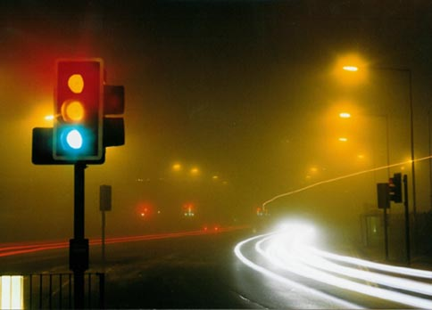
i-Clickers: Traffic lights
How are you doing with this topic? Imagine a set of traffic lights, and indicate how close you feel to READY TO GO!
1
2
3
4
5
Struggling (red)
In the middle (amber)
Fully understand (green)
Notes:
Go over material again depending on class “temperature”, or group students in mixed temperature groups and ask to identify and discuss muddy points, or group students according to temperature and give extension work to the green group while going over material again for amber/red

Slide 16
CONTINUUM
Come up to the front and stand in a line according to how confident you feel in answering the question below:
QUESTION
VERY UNDER-CONFIDENT
SUPER AWESOMELY CONFIDENT
Notes:
Ask those on the right-hand side for answers, or ask those in the middle and get those on the right-hand side to elaborate, then ask those on the left-hand side for a summary

Slide 17
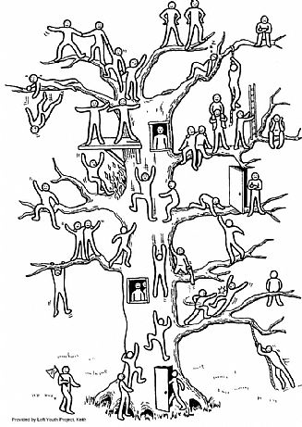
EVALUATION TREE
Which of the people on the tree symbolizes how you feel in relation to the lesson material, the exam, the paper?
Circle it and say why:
Notes:
Best in small discussion-based classes

Slide 18
Conversation Starters

Slide 19
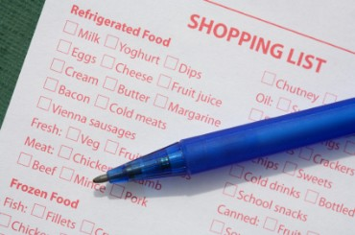
LISTFINITION
We are going to write a collective DEFINITION of […].
First, in 1 minute, individually list all the words that you can think of to do with […].
Then we will join into pairs to combine our words into definitions.
Notes:
Can be used at the beginning of a topic if the term is an ordinary language term. Development: pairs join into 4s and compare answers.

Slide 20
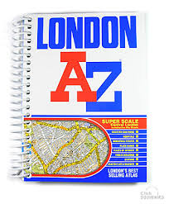
A TO Z
Write down a word associated with [TOPIC] for as many letters of the alphabet as you can.
e.g. (if the topic was “fruit”):
Apple
Banana
Citrus
Deliciousness
etc.
Notes:
Variation on the above

Slide 21
CONTINUUM
Come up to the front and stand in a line according to how strongly you agree with the sentence below:
SENTENCE
STRONGLY DISAGREE
STRONGLY AGREE
Notes:
Personal favorite! Can ask students up and down the line to explain “where they stand”, allowing others to move up and down to the extent that they are persuaded. Development 1 (if class is polarized): divide into two teams and have a team debate. Development 2 (if evenly spread): divide into three groups, “agree”, “disagree” and “we should suspend judgment”, and ask groups to write short speeches defending their position.

Slide 22
SILENT DEBATE
As you move around the room, write answers to the questions on each of the sheets.
Once you have been around once, go again and write a response to someone else’s answer on each sheet.
The trick: this must all be done in ABSOLUTE SILENCE.
Notes:
Another favorite! Prepare by writing up 4-5 claims from the reading (paraphrased or quotations) on A3 sheets of paper and sticking them up around the room as students enter. Particularly useful for contentious topics, or ones with respect to which students might experience stereotype threat – this activity minimizes identity and focuses exclusively on the content of people’s points. Can sell it as a way to practice developing the skill of coming up with counterarguments and counter-counter-arguments. Development: place students in groups, give each group an A3 sheet, and ask them to select the 2-3 best points and report back to the class.

Slide 23
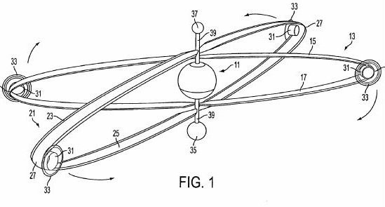
ROTATION STATIONS!
Each group will be given a sheet of paper. Write your answers to the question on the sheet in the inner circle.
We will then rotate the sheets and write comments on each others’ answers in the next concentric circle.
We will then rotate again and write comments on the comments – no skipping a ring!!
Notes:
Variation on silent debate, but not silent – encourages group discussion, but still has students responding to one another’s points.

Slide 24
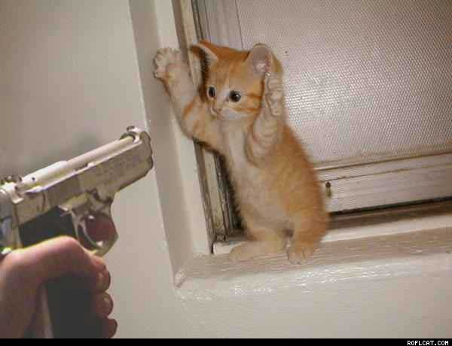
STICK ’EM UP!
QUESTION
QUESTION
QUESTION
Write your answer to your chosen question on a post-it note and come stick it up on the board.
(Green = straightforward, amber = middle, red = hardest)
Notes:
Traffic lights incorporate differentiation – students self-select a question at the right level for them. Can then group students into color groups for further discussion.

Slide 25
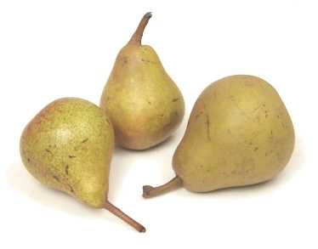
PAIR TALK
We are going to have a focussed discussion in pairs about the question on the next slide.
First, person A will have 2 minutes to talk and person B will listen. Then we will swap round.
Notes:
Helpful way to force students to equalize talking time. Suggestions: How would you reply to claim X in the reading? What was the strongest argument in the reading? What helpful tips would you give students taking this class next year?

Slide 26
i-Clickers: ODD ONE OUT
Answer using your i-Clickers:
Which is the odd one out: A, B or C?
Notes:
Group students and ask to share and discuss their answers. Can work with big classes; just ask to discuss with whoever is sitting near to them.

Slide 27
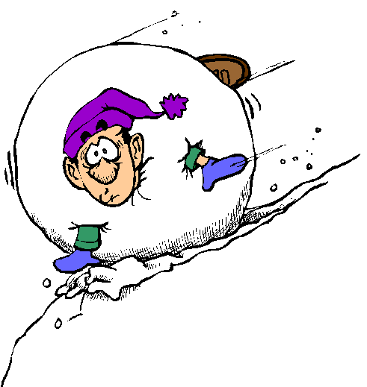
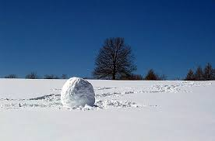
SNOWBALL!
Individually, you will have 1 minute to write down an answer to the question on the next slide.
Then I will ask you to get into pairs, and I will give you 2 minutes synthesize your two answers down to 1.
Then we will get into groups of 4, and then 8.
Notes:
Pro tip: create graphic organizers with space for students to write down not only their individual answer, but also the answers from their pair, their 4, and their 8. Development: add optional extra questions for the 4s and 8s. Ask a representative of each 8 to feed back to the class.

Slide 28
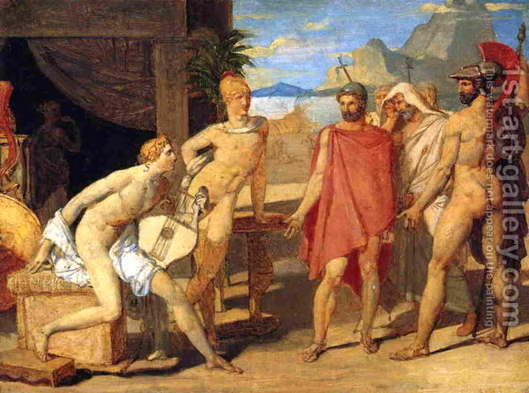
ENVOYS
We are going to split into four groups, and each group will be given a different case to discuss.
After 10 minutes, each group will send ENVOYS to all the other groups to learn what they said about their cases, and the envoys will each report back.
Finally, each group will be asked to come up with a principle or rule that best covers all of the cases.
Notes:
Requires that the number of groups is less than or equal to the number of people per group. Helpful to have graphic organizers for students to write down notes about each case. Variation: Do this not with cases but with philosophical theories, and ask students to note what the theory says and any problems they see with it.

Slide 29
MR. WRONG
Poor Mr. Wrong. He tries hard to do his reading and to remember it, but he ends up getting a lot of it wrong.
Can you help him out??
Notes:
Another favorite – and a great way to clear up common misconceptions. Can be an end-of-lesson AfL activity, but can also be a group discussion activity; e.g. give groups an envelope of Mr. Wrongs giving bad arguments or saying false things, have groups discuss and explain what’s wrong. Pro tip: do this with objections to an argument in the reading, and have groups explain why the objection is bad, for readings (e.g. Famine, Affluence and Morality) that are often met with really bad objections!!

Slide 30
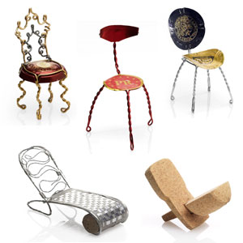
REDESIGN
Imagine you are a team of design experts.
How would you REDESIGN […] to make it more appealing?
In groups of 4, draw or write out your ideas for your design, and plan an advertising spiel to sell it to the rest of the class.
We will then vote for our favorite designs!
Notes:
Can apply to a something in the world that the reading has been criticizing (e.g. the electoral process). Or to a philosophical theory or an argument or position from a historical text that the class has been criticizing. N.B. The latter is pretty advanced – a good extension activity.

Slide 31
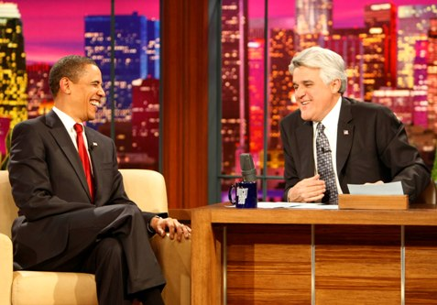
TV CHAT SHOW!
Next class, teams of four people are going to play the role of guests in a TV chat show – they will each be philosophers whose works we have studied.
The rest of the class will “phone in” with questions.
I would like each of you to prepare to play the role of one of our four philosophers. Next class we will rotate through.
Notes:
Amazing review activity for a small class of outgoing keeners! Assign particular philosophers to particular students (or have them sign up) so they don’t all do the same one.

Slide 32
EMPIRICAL OR EVALUATIVE?
Some of the claims in […] are supposed to be empirical claims that we could test and gain empirical evidence for.
Others are evaluative claims that must be argued for. NOTE: THESE CLAIMS CAN STILL BE TRUE/FALSE!
Can you identify 5 examples of each?
Notes:
Better version of “fact or opinion”. Use to discourage knee-jerk relativism; the distinction makes sense, if at all, as a distinction between ways to establish a claim

Slide 33
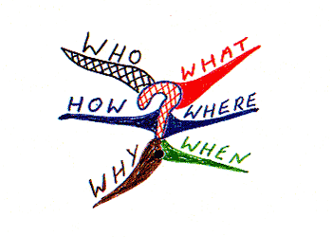
Questions you would like to ask
For the next 8 classes we will be studying [TOPIC].
What questions would you like to know the answer to?
Write them on a card and hand it to me as you leave.
Notes:
Nice way to build student feedback into your planning! Development: give cards back to students at the end of the topic and have them write answers.

Slide 34
CHANGE THE WORLD
How could the ideas we have discussed today change the world? Locally, nationally, internationally…?
Notes:
Nice way to end a class/unit on something applied. Stimulus for discussion in whatever is your preferred format. Demonstrate the point of Philosophy!!

